Slide 1
Sorting algorithms

Slide 2
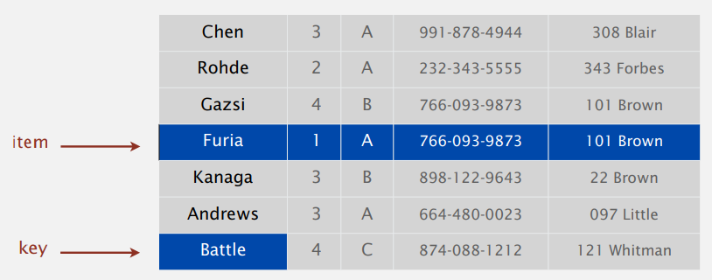
Introduction to sorting
Sorting is the process of placing elements from a collection in some kind of order
(a₀, a₁, ..., a_{n – 1}) → a'₀ ≤ a'₁ ≤ · · · ≤ a'_{n – 1}
Different sorting criteria exist:
A list of words could be sorted alphabetically or by length
A list of cities could be sorted by population, by area, or by zip code
Several important algorithms in computer science benefit from having a sorted list
Binary search
Sorting a large number of items can take a substantial amount of computing resources
The efficiency of a sorting algorithm is related to the number of items being processed
Operations that can be used to analyze a sorting process
Number of comparisons between 2 values
Number of exchanges when values are not in the correct position
Notes:
Many sorting algorithms have been developed and analysed over time
This suggests sorting is an important area of study in computer science
the exchange is a costly operation and the total number of exchanges will also be important for evaluating the overall efficiency of the algorithm.

Slide 3
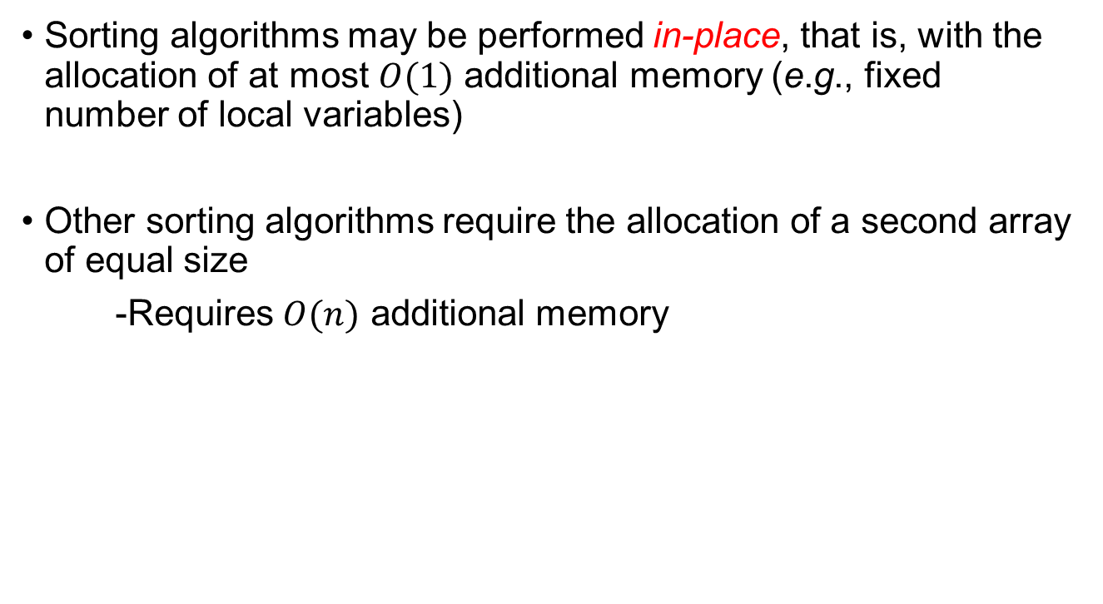
In-place Sorting
Sorting algorithms may be performed in-place, that is, with the allocation of at most $O(1)$ additional memory (e.g., fixed number of local variables)
Other sorting algorithms require the allocation of a second array of equal size
-Requires $O(n)$ additional memory

Slide 4
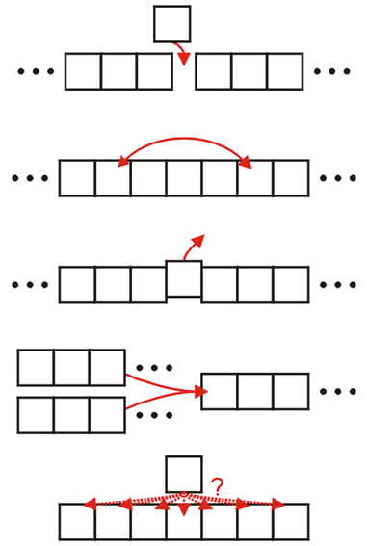
Operations of sorting algorithms
The operations of a sorting algorithm are based on the actions performed:
Insertion
Exchanging
Selection
Merging
Distribution

Slide 5
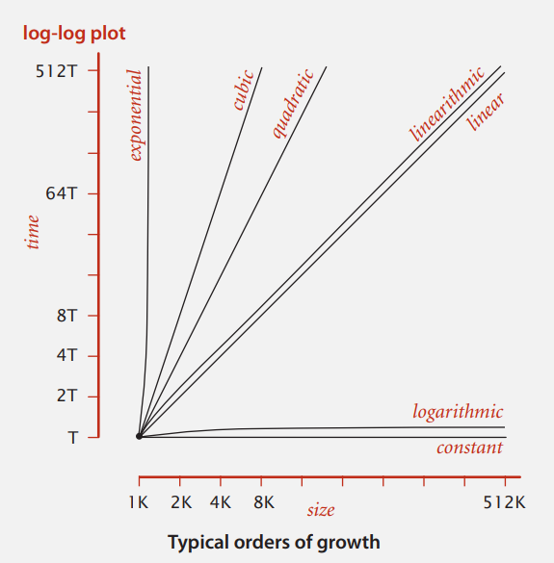
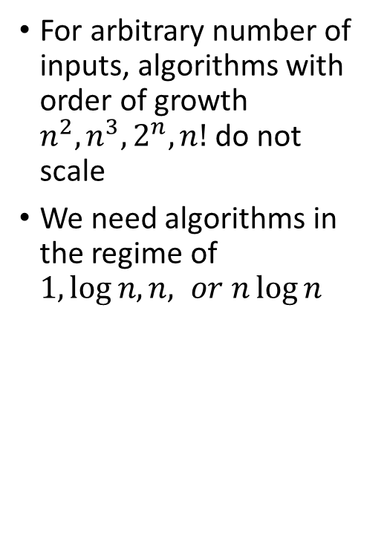
Common order of growth classifications
For arbitrary number of inputs, algorithms with order of growth $n^{2},n^{3},2^{n},n!$ do not scale
We need algorithms in the regime of $1,log{n, n, or n\log{n }}$

Slide 6
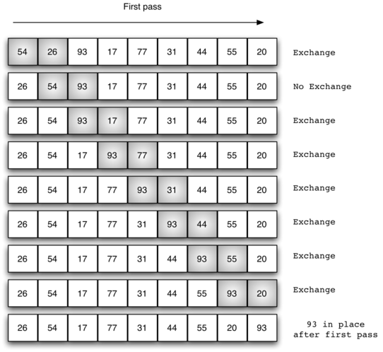
Bubble Sort
The bubble sort makes multiple passes through a list
It compares adjacent pairs of items and exchanges those that are out of order
Each pass through the list places the next largest value in its proper place
In essence, each item “bubbles” up to the location where it belongs
Once the largest value in the list is part of a pair, it will continually be moved along until the pass is complete.
Notes:
The figure shows the first pass of a bubble sort. The shaded items are being compared to see if they are out of order. If there are n items in the list, then there are $n−1$ pairs of items that need to be compared on the first pass. It is important to note that once the largest value in the list is part of a pair, it will continually be moved along until the pass is complete.
At the start of the second pass, the largest value is now in place. There are $n−1$ items left to sort, meaning that there will be $n−2$ pairs. Since each pass places the next largest value in place, the total number of passes necessary will be $n−1$. After completing the $n−1$ passes, the smallest item must be in the correct position with no further processing required.

Slide 7
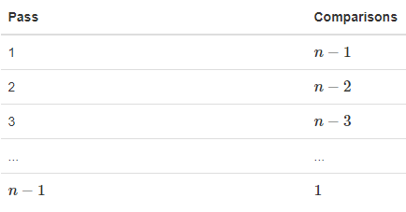
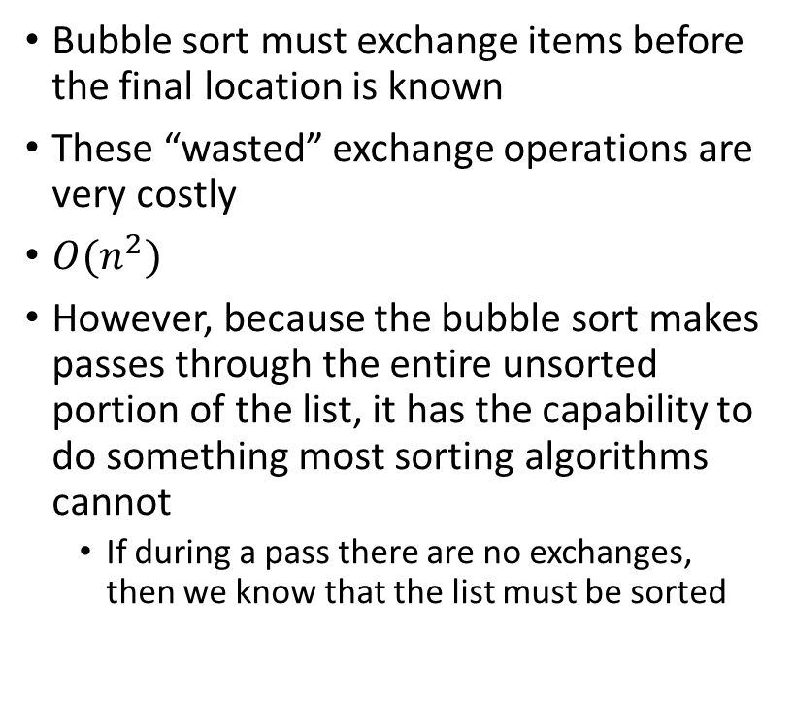
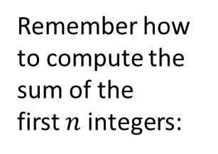
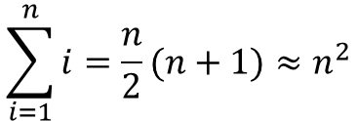
Bubble Sort is considered one of the most inefficient sorting method (brute force would be even worse)
Bubble sort must exchange items before the final location is known
These “wasted” exchange operations are very costly
$O(n^{2})$
However, because the bubble sort makes passes through the entire unsorted portion of the list, it has the capability to do something most sorting algorithms cannot
If during a pass there are no exchanges, then we know that the list must be sorted
Remember how to compute the sum of the first $n$ integers:
$$\sum_{i=1}^{n}{i=\frac{n}{2}(n+1)≈n^{2}}$$
Notes:
A bubble sort can be modified to stop early if it finds that the list has become sorted. This means that for lists that require just a few passes, a bubble sort may have an advantage in that it will recognize the sorted list and stop.

Slide 8
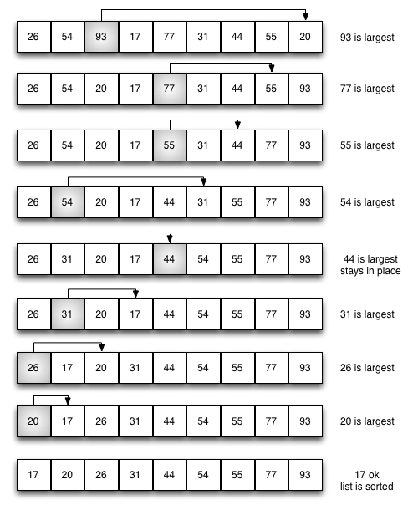
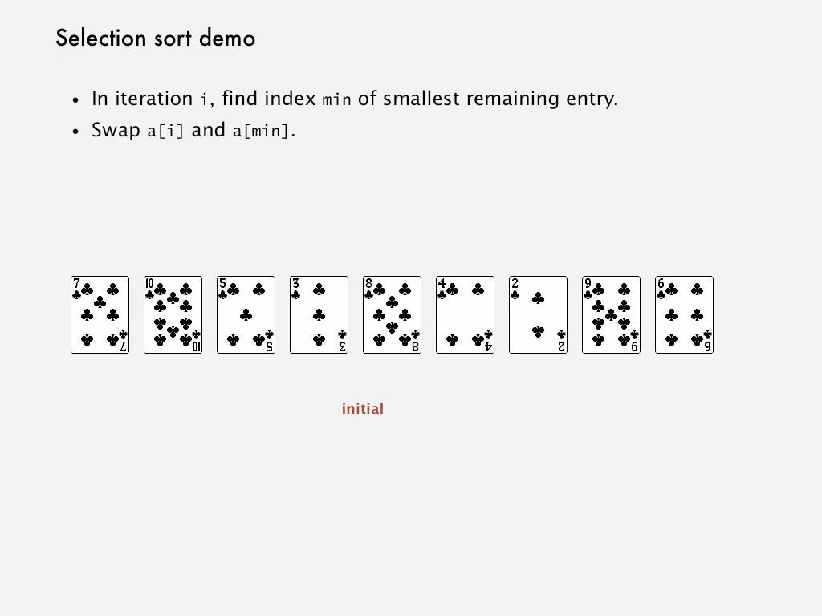
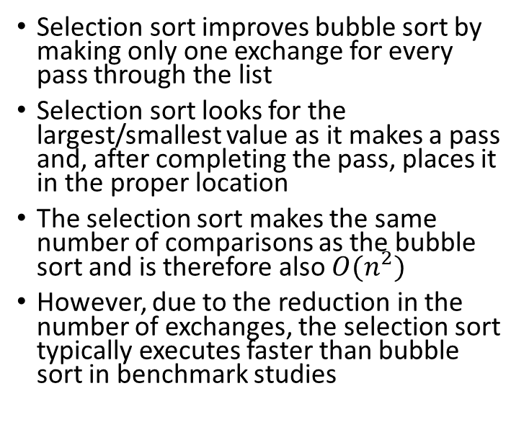
Selection Sort
Selection sort improves bubble sort by making only one exchange for every pass through the list
Selection sort looks for the largest/smallest value as it makes a pass and, after completing the pass, places it in the proper location
The selection sort makes the same number of comparisons as the bubble sort and is therefore also $O(n^{2})$
However, due to the reduction in the number of exchanges, the selection sort typically executes faster than bubble sort in benchmark studies
Notes:
The figure shows the entire sorting process. On each pass, the largest remaining item is selected and then placed in its proper location.
As with a bubble sort, after the first pass, the largest item is in the correct place.
After the second pass, the next largest is in place.
This process continues and requires $n−1$ passes to sort $n$ items, since the final item must be in place after the $n−1$ pass

Slide 9
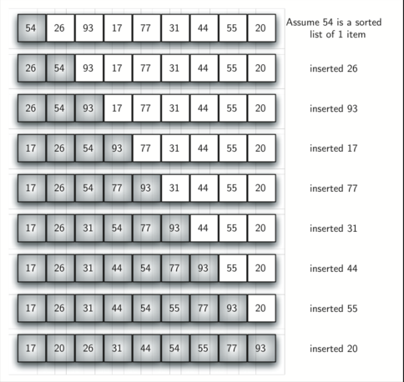
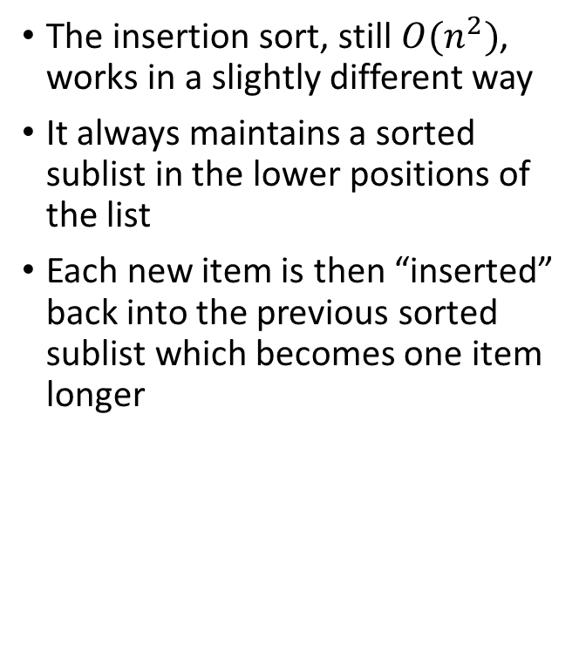
Insertion Sort
The insertion sort, still $O(n^{2})$, works in a slightly different way
It always maintains a sorted sublist in the lower positions of the list
Each new item is then “inserted” back into the previous sorted sublist which becomes one item longer
Notes:
Figure shows the insertion sorting process. The shaded items represent the ordered sublists as the algorithm makes each pass.

Slide 10
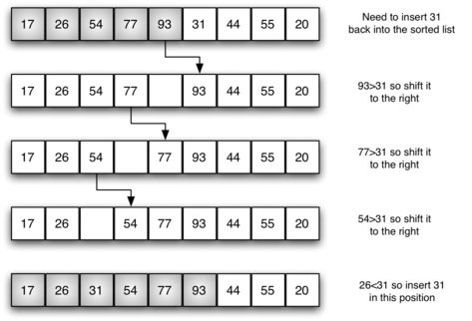
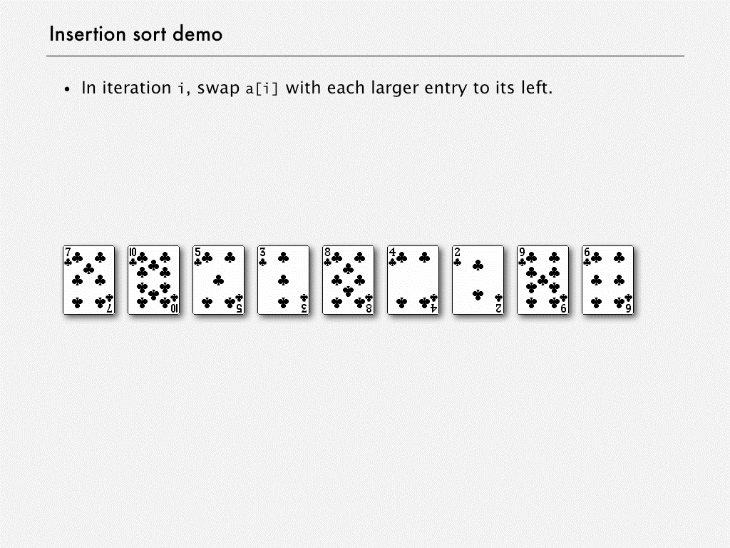
Insertion Sort - fifth pass in detail
In the 5th pass we start with a sorted sublist of 5 items
We want to insert 31 back into the already sorted sublist
The first comparison against 93 causes 93 to be shifted to the right 77 and 54 are also shifted
When the item 26 is encountered, the shifting process stops and 31 is placed in the open position
Now we have a sorted sublist of 6 items.
Notes:
Figure shows the insertion sorting process. The shaded items represent the ordered sublists as the algorithm makes each pass.
One note about shifting versus exchanging is also important. In general, a shift operation requires approximately a third of the processing work of an exchange since only one assignment is performed. In benchmark studies, insertion sort will show very good performance.

Slide 11
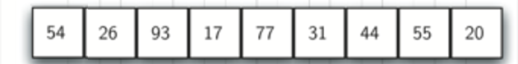
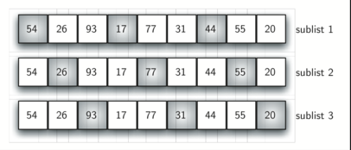
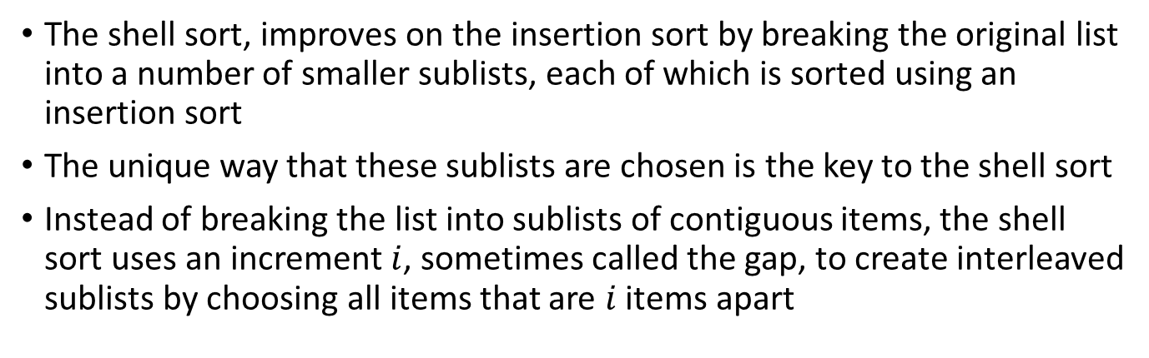
The Shell Sort
The shell sort, improves on the insertion sort by breaking the original list into a number of smaller sublists, each of which is sorted using an insertion sort
The unique way that these sublists are chosen is the key to the shell sort
Instead of breaking the list into sublists of contiguous items, the shell sort uses an increment $i$, sometimes called the gap, to create interleaved sublists by choosing all items that are $i$ items apart
Original list broken into three sublists
54,17,44
26,77,55
93,31,20

Slide 12
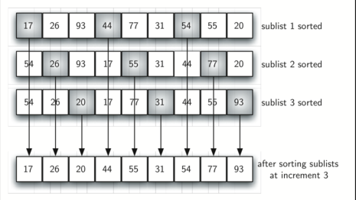
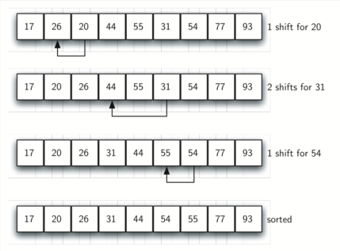
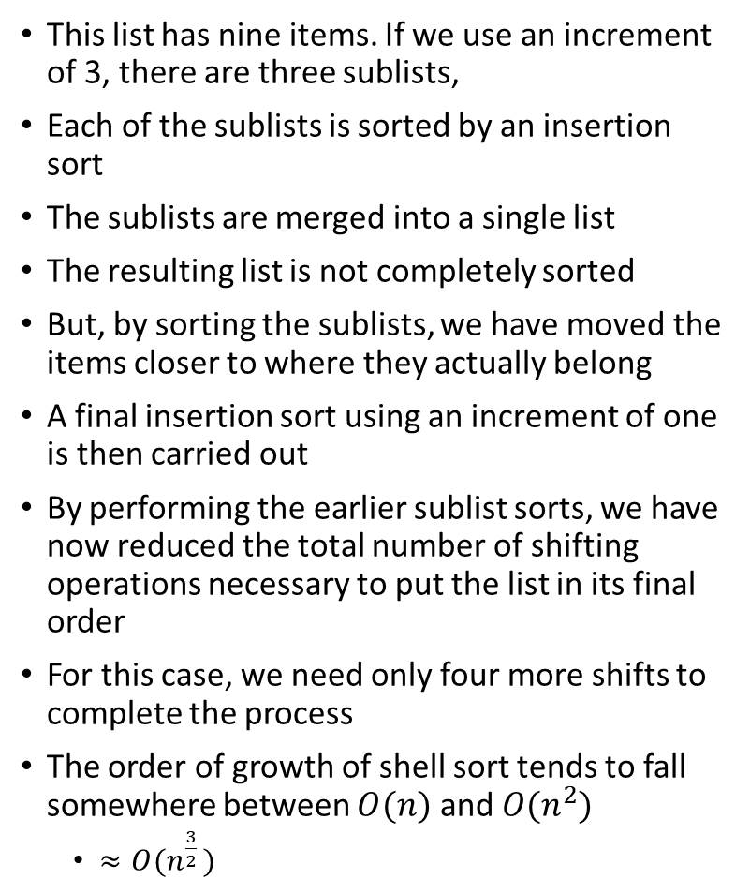
The Shell Sort
This list has nine items. If we use an increment of 3, there are three sublists,
Each of the sublists is sorted by an insertion sort
The sublists are merged into a single list
The resulting list is not completely sorted
But, by sorting the sublists, we have moved the items closer to where they actually belong
A final insertion sort using an increment of one is then carried out
By performing the earlier sublist sorts, we have now reduced the total number of shifting operations necessary to put the list in its final order
For this case, we need only four more shifts to complete the process
The order of growth of shell sort tends to fall somewhere between $O(n)$ and $O(n^{2})$
$≈O({n^{\frac{3}{2}}}^{ })$

Slide 13

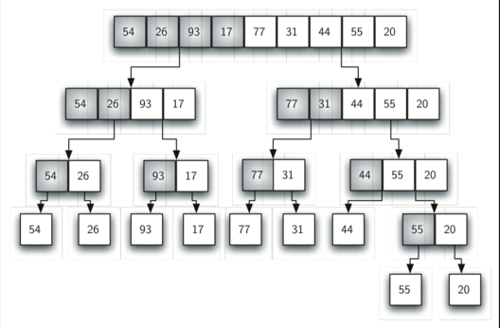
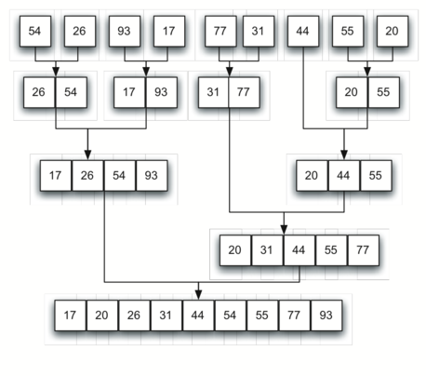
Merge Sort
Splitting
Divide and conquer strategy as a way to improve the performance of sorting algorithms
Merge sort is a recursive algorithm that continually splits a list in half
If the list is empty or has one item, it is sorted by definition (base case)
If the list has more than one item, we split the list and recursively invoke a merge sort on both halves
Once the two halves are sorted, the fundamental operation, called a merge, is performed
Merging is the process of taking two smaller sorted lists and combining them together into a single, sorted, new list
Merging the sorted lists
Notes:
John von Neumann (December 28, 1903 – February 8, 1957) was a Hungarian-American mathematician, physicist, computer scientist, and polymath. He made major contributions to a number of fields, including mathematics (foundations of mathematics, functional analysis, ergodic theory, representation theory, operator algebras, geometry, topology, and numerical analysis), physics (quantum mechanics, hydrodynamics, and quantum statistical mechanics), economics (game theory), computing (Von Neumann architecture, linear programming, self-replicating machines, stochastic computing), and statistics.
Von Neumann was a founding figure in computing. Donald Knuth cites von Neumann as the inventor, in 1945, of the merge sort algorithm, in which the first and second halves of an array are each sorted recursively and then merged. Von Neumann wrote the 23 pages long sorting program for the EDVAC in ink. On the first page, traces of the phrase "TOP SECRET", which was written in pencil and later erased, can still be seen. He also worked on the philosophy of artificial intelligence with Alan Turing when the latter visited Princeton in the 1930s.
Von Neumann's hydrogen bomb work was played out in the realm of computing, where he and Stanisław Ulam developed simulations on von Neumann's digital computers for the hydrodynamic computations. During this time he contributed to the development of the Monte Carlo method, which allowed solutions to complicated problems to be approximated using random numbers.. His algorithm for simulating a fair coin with a biased coin is used in the "software whitening" stage of some hardware random number generators

Slide 14
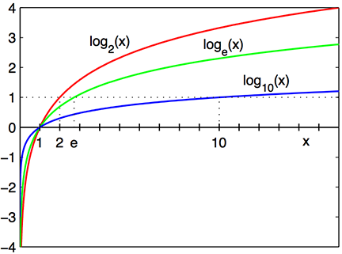
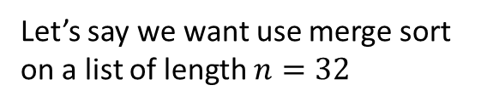
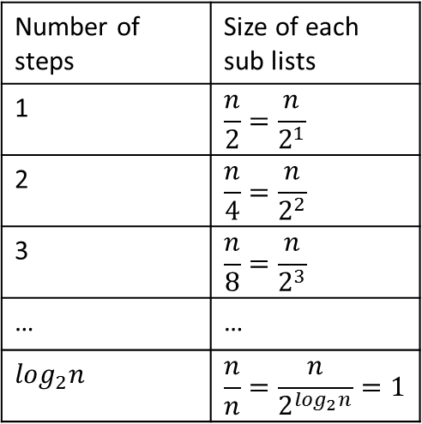
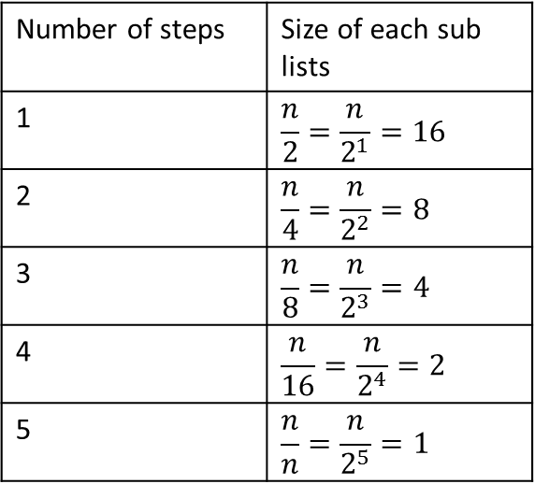
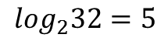
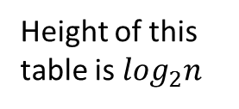
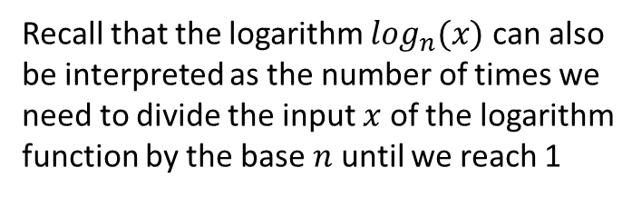
Reminder of logarithmic function
Recall that the logarithm $\log_{n}(x)$ can also be interpreted as the number of times we need to divide the input $x$ of the logarithm function by the base $n$ until we reach 1
Let’s say we want use merge sort on a list of length $n=32$
$$\log_{2}32=5$$
Number of steps | Size of each sub lists
1 | $$\frac{n}{2}=\frac{n}{2^{1}}$$
2 | $$\frac{n}{4}=\frac{n}{2^{2}}$$
3 | $$\frac{n}{8}=\frac{n}{2^{3}}$$
… | …
$$\log_{2}n$$ | $$\frac{n}{n}=\frac{n}{2^{\log_{2}n}}=1$$
Number of steps | Size of each sub lists
1 | $$\frac{n}{2}=\frac{n}{2^{1}}=16$$
2 | $$\frac{n}{4}=\frac{n}{2^{2}}=8$$
3 | $$\frac{n}{8}=\frac{n}{2^{3}}=4$$
4 | $$\frac{n}{16}=\frac{n}{2^{4}}=2$$
5 | $$\frac{n}{n}=\frac{n}{2^{5}}=1$$
Height of this table is $\log_{2}n$
Notes:
The logarithmic function has a huge dampening effect for large values of x

Slide 15
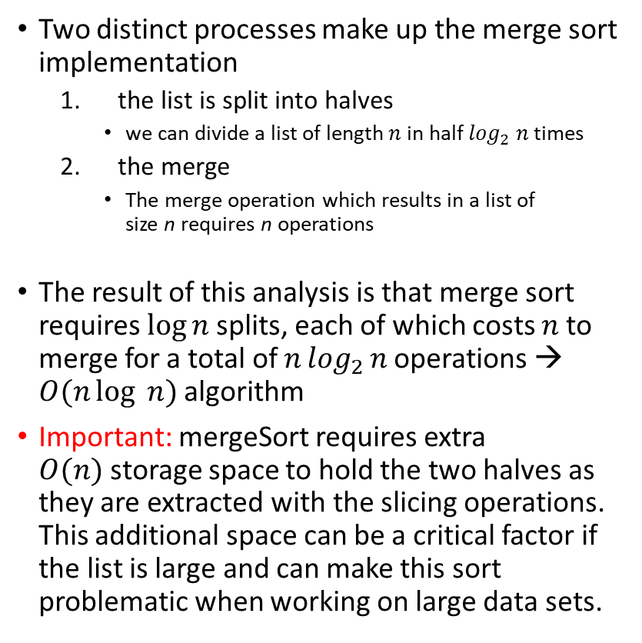
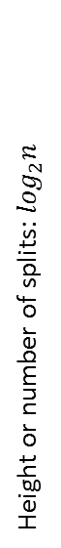
Analyzing merge sort
Splitting
Height or number of splits: $\log_{2}n$
Two distinct processes make up the merge sort implementation
the list is split into halves
we can divide a list of length $n$ in half $\log_{2} n$times
the merge
The merge operation which results in a list of size n requires n operations
The result of this analysis is that merge sort requires $\log{n}$ splits, each of which costs $n$ to merge for a total of $n\log_{2}{n}$operations → $O(n\log{ n})$ algorithm
Important: mergeSort requires extra $O(n)$storage space to hold the two halves as they are extracted with the slicing operations. This additional space can be a critical factor if the list is large and can make this sort problematic when working on large data sets.
Merging the sorted lists

Slide 16
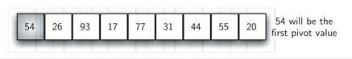
Quick Sort
Quick sort uses divide and conquer to gain the same advantages as the merge sort, while not using additional storage
As a trade-off, however, it is possible that the list may not be divided in half
When this happens, performance is diminished
A quick sort first selects a value, which is called the pivot value.
The role of the pivot value is to assist with splitting the list
The actual position where the pivot value belongs in the final sorted list, commonly called the split point, will be used to divide the list for subsequent calls to the quick sort.
Notes:
Although there are many different ways to choose the pivot value, we will simply use the first item in the list.

Slide 17
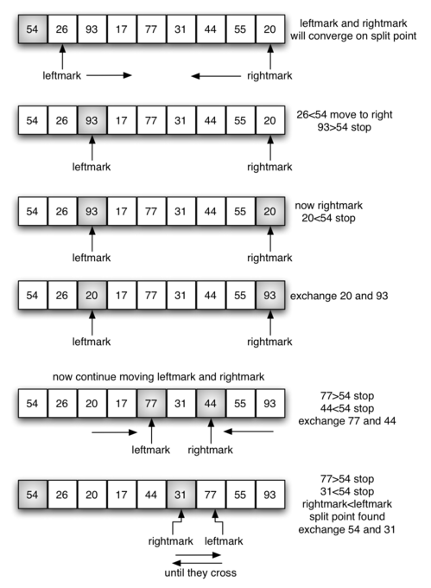
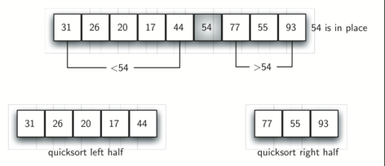
Quick Sort
The partition process will happen next
The goal of the partition process is to move items to the appropriate side of the list, either less than or greater than the pivot value while also converging on the split point
The figure shows this process as we locate the position of 54
The pivot value can be exchanged with the contents of the split point and the pivot value is now in place
In addition, all the items to the left of the split point are less than the pivot value, and all the items to the right of the split point are greater than the pivot value
The list can now be divided at the split point and the quick sort can be invoked recursively on the two halves

Slide 18
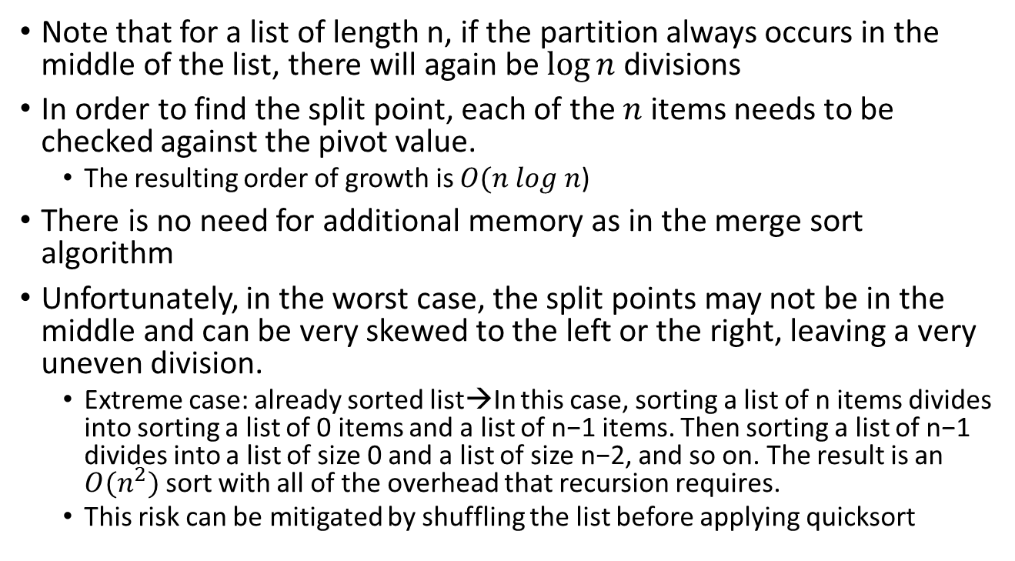
Quick Sort
Note that for a list of length n, if the partition always occurs in the middle of the list, there will again be $\log{n}$ divisions
In order to find the split point, each of the $n$ items needs to be checked against the pivot value.
The resulting order of growth is $O(n log n$)
There is no need for additional memory as in the merge sort algorithm
Unfortunately, in the worst case, the split points may not be in the middle and can be very skewed to the left or the right, leaving a very uneven division.
Extreme case: already sorted list→In this case, sorting a list of n items divides into sorting a list of 0 items and a list of n−1 items. Then sorting a list of n−1 divides into a list of size 0 and a list of size n−2, and so on. The result is an $O(n^{2})$ sort with all of the overhead that recursion requires.
This risk can be mitigated by shuffling the list before applying quicksort

Slide 19
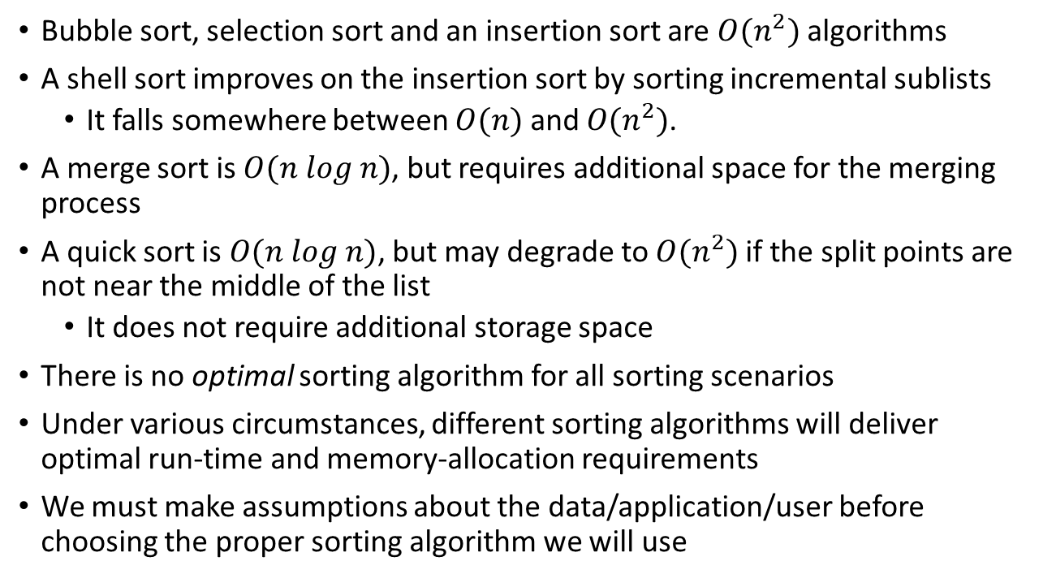
Take-home message
Bubble sort, selection sort and an insertion sort are $O(n^{2})$ algorithms
A shell sort improves on the insertion sort by sorting incremental sublists
It falls somewhere between $O(n)$ and $O(n^{2})$.
A merge sort is $O(n log n)$, but requires additional space for the merging process
A quick sort is $O(n log n)$, but may degrade to $O(n^{2})$ if the split points are not near the middle of the list
It does not require additional storage space
There is no optimal sorting algorithm for all sorting scenarios
Under various circumstances, different sorting algorithms will deliver optimal run-time and memory-allocation requirements
We must make assumptions about the data/application/user before choosing the proper sorting algorithm we will use

